Slide 1
Cognitive architecture (LIDA)
functioning in realistic environment
Localization Model
Map correction Model
Map structuring
Model

Slide 2
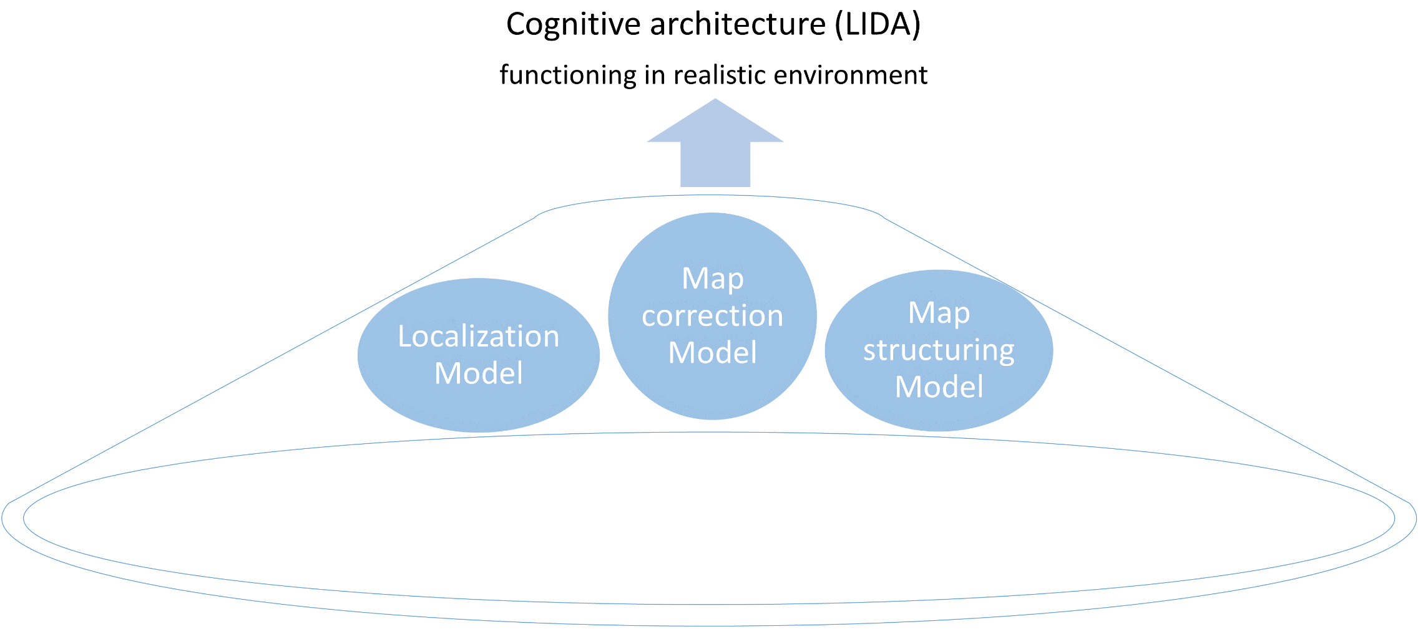
Modelling
method
Type of
Data
Neural
Beha-
viour
Place cell firing in different environments
Structure¹ of spatial memories in optimally² generated environments
Structure of existing spatial memories in familiar³ environments
Accuracy⁴ of existing spatial memories in familiar environments
Data
collection
method
Neural
Beha- viour
Single-cell recording (not in this PhD)
Virtual reality experiment
Online behavioural experiment (MTurk)
Preliminary experiments in virtual reality (Appendix C)

